Slide 2
CH 20 Metabolism of Nitrogenous Compounds l: Principles of Biosynthesis, Utilization,and Turnover

Slide 3
舉出兩種酵素其調控具有Feedback inhibition and covalent modifications之機制
Glutamine synthetase, adenyltransferase

Slide 4
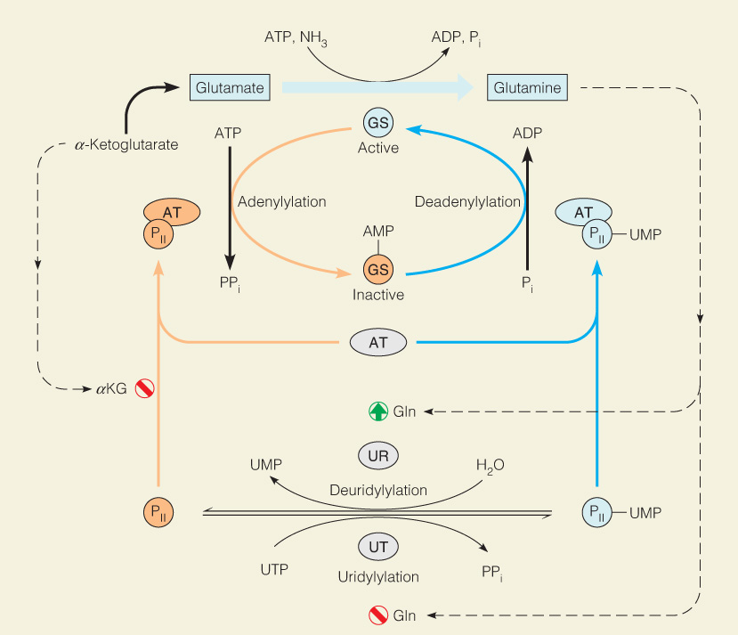
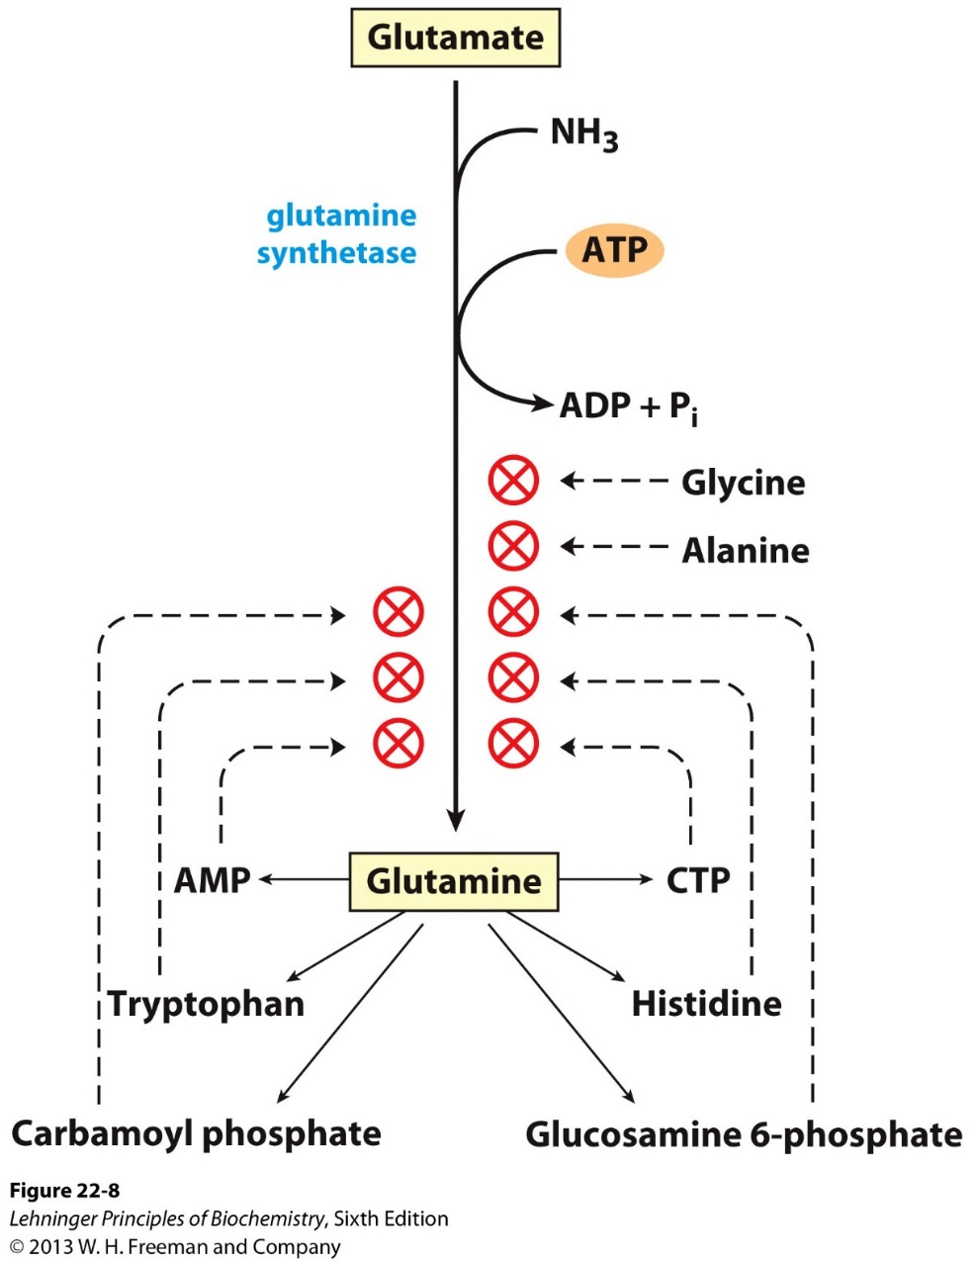
CH20 – No.1
Covalent modification
Feedback inhibition

Slide 5
nitrogenase含有哪些特殊金屬離子?
Fe²⁺, Mo

Slide 6
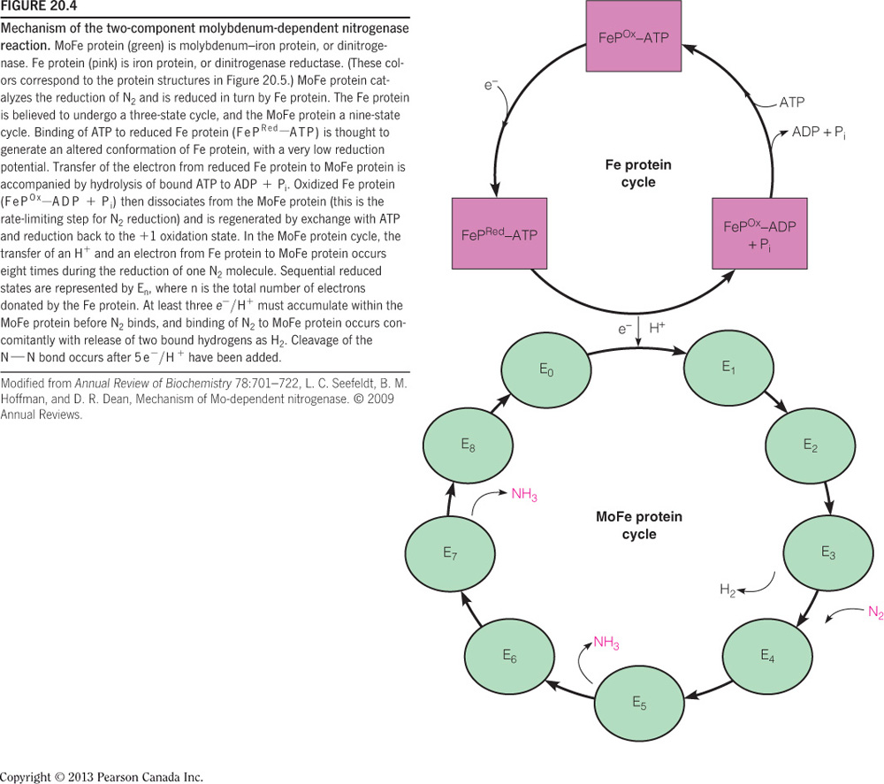
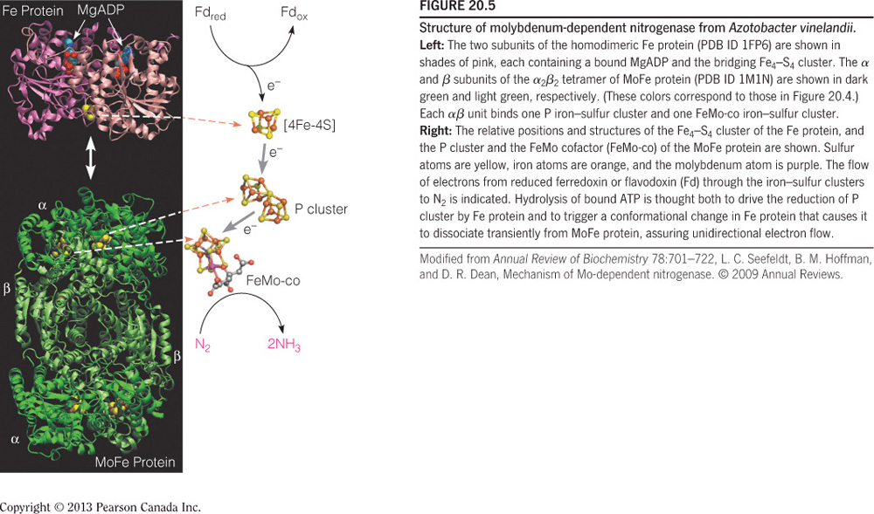
CH20 – No.2

Slide 7
試說明nitrogen fixation, nitrification, denitrification之反應式
Nitrogen fixation: N₂ → NH₄⁺
Nitrification: NH4⁺ → NO₂⁻(nitrite) → NO₃⁻(nitrate)
Denitrification: NO₃⁻ → N₂

Slide 8
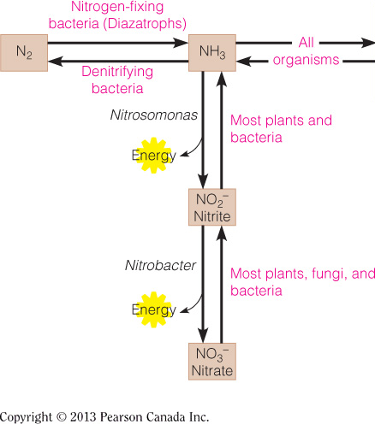
CH20 – No.3
Nitrogen fixation
Nitrification
Denitrification

Slide 9
Transamination反應中所需的輔酶為何?
PLP (pyridoxal phosphate)

Slide 10
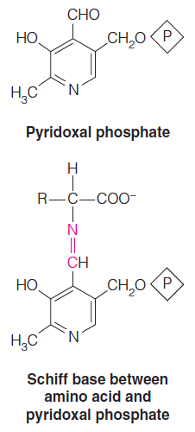
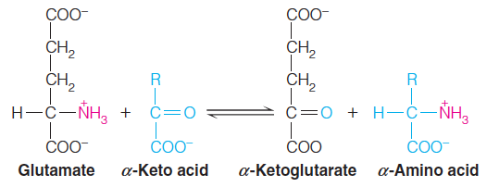
CH20 – No.5
PLP
PLP
Intermediate

Slide 11
NH₄具有毒性之原因為何?
Ammonia的毒性來自其對胺基酸和能量代謝的影響。Ammonia的累積會使glutamate dehydrogenase反應不斷進行，大量消耗TCA cycle的中間產物和NADH，並使ATP不足。另外也會影響CNS。

Slide 12
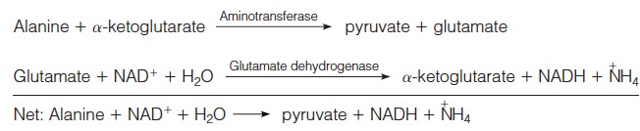
CH20 – No.6
Ammonia的毒性來自其對胺基酸和能量代謝的影響。Ammonia的累積會使glutamate dehydrogenase反應不斷進行，大量消耗TCA cycle的中間產物(alpha-ketoglutarate)和NADH，並使ATP不足。另外也會影響CNS。

Slide 13
哺乳類動物尿素的形成,主要在何種器官進行
Liver

Slide 14
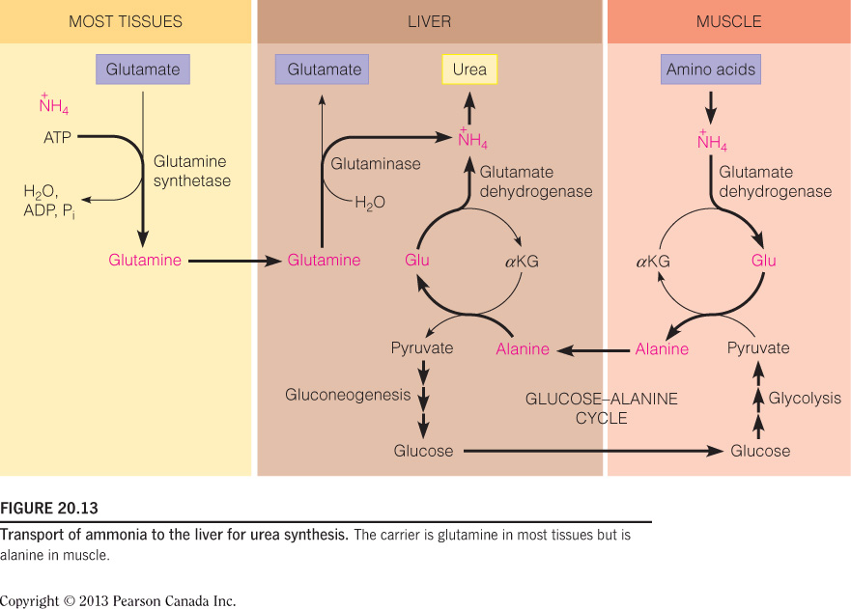
CH20 No.7
glucose–alanine cycle

Slide 15
氨基酸代謝過程中,最後是以哪兩種胺基酸的形式,提供NH₄⁺用於尿素之生成反應
Aspartate, glutamate

Slide 16
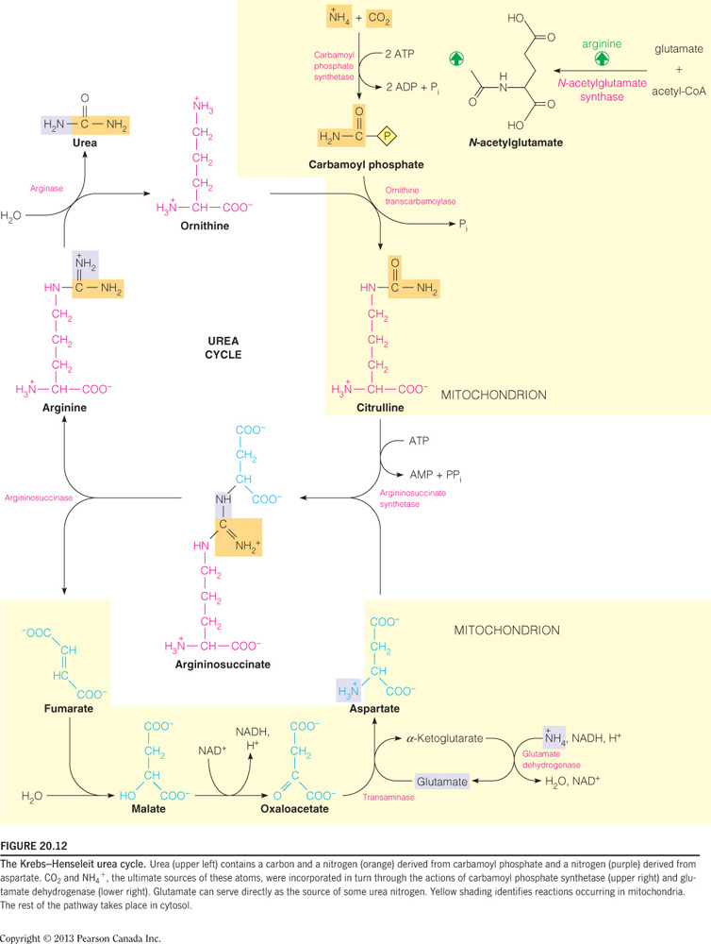
CH20 - No.8
The Krebs–Henseleit urea cycle:

Slide 17
氨基酸有二十種,其氨基(amino group)的代謝會收斂到哪一種氨基酸才進入尿素循環,此反應名稱及
受質為何
Glutamate; amino group catabolism

Slide 18
CH20 No.9
glucose–alanine cycle

Slide 19
尿素(urea)為下列哪一種酵素所直接催化之代謝產物?
Arginase

Slide 20
CH20 – No.10

Slide 21
組織所產生的NH₄⁺以何種形式運送到代謝的器官
Glutamine

Slide 22
CH20 No.11
glucose–alanine cycle

Slide 23
試舉出三種參與one-carbon transfer反應的cofactor (別忘了biotin)
biotin, tetrahydrofolate(THF), Vit.B₁₂

Slide 24
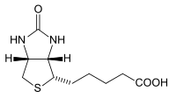
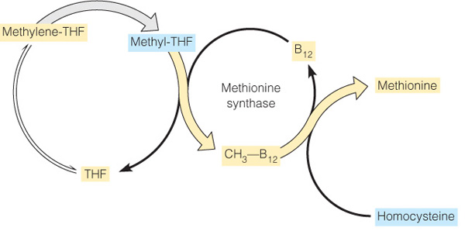
CH20 – No.12
Biotin (Carbaxylation)

Slide 25
試舉出三種Pyridoxal phosphate參與的反應
Serine → glycine
tryptophan, isoleucine的合成
Glutamate + oxaloacetate → α-ketoglutarate + aspartate
Glutamate + pyruvate → α-ketoglutarate + alanine

Slide 26
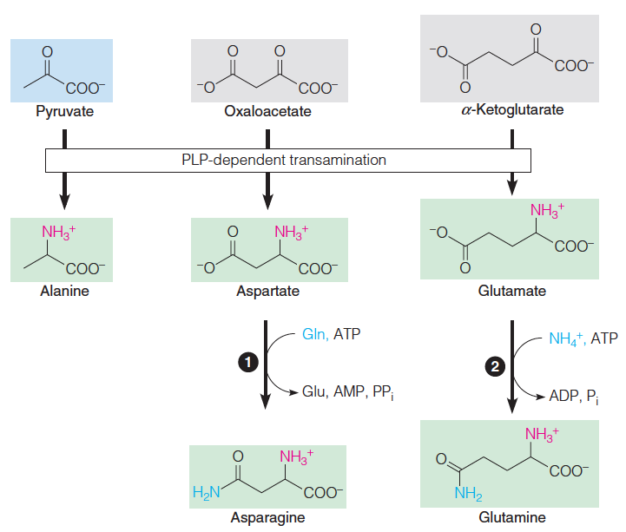
CH20 – No.14
Glutamate + oxaloacetate → α-ketoglutarate + aspartate
Glutamate + pyruvate → α-ketoglutarate + alanine

Slide 27
Homocysteine再生形成methionine需要哪些輔酶
B₁₂, tetrahydrofolate (THF)

Slide 28
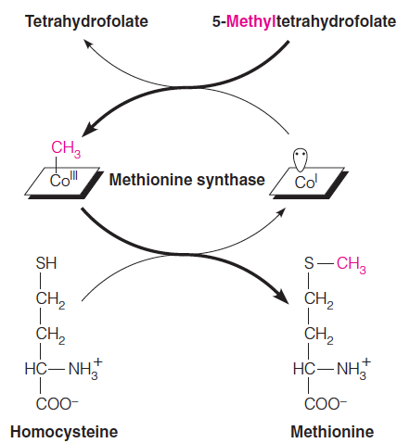
CH20 No.15
THF
Vitamin B12

Slide 29
Alanine aminotransferase的另一個名稱為何,它催化哪一個反應
Glutamate-pyruvate transaminase (GPT)
Glutamate + pyruvate → α-ketoglutarate + alanine

Slide 30
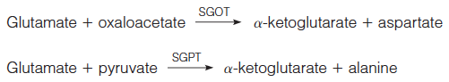
CH20 – No.16
serum glutamate-oxaloacetate transaminase
Aspartate aminotransferase (AST)
serum glutamate-pyruvate transaminase
Alanine aminotransferase (ALT)

Slide 31
試舉出兩種平衡常數=1之生化反應(△G⁰’=0)
Glutamate + oxaloacetate → α-ketoglutarate + aspartate
Glutamate + pyruvate → α-ketoglutarate + alanine

Slide 32
CH20 – No.17
K = 1
serum glutamate-oxaloacetate transaminase
Aspartate aminotransferase (AST)
K = 1
serum glutamate-pyruvate transaminase
Alanine aminotransferase (ALT)

Slide 33
Carbamoyl phosphate synthetase I會受到哪些分子的直接或間接調控
間接Glutamate, acetyl-CoA, arginine
直接N-acetylglutamate

Slide 34
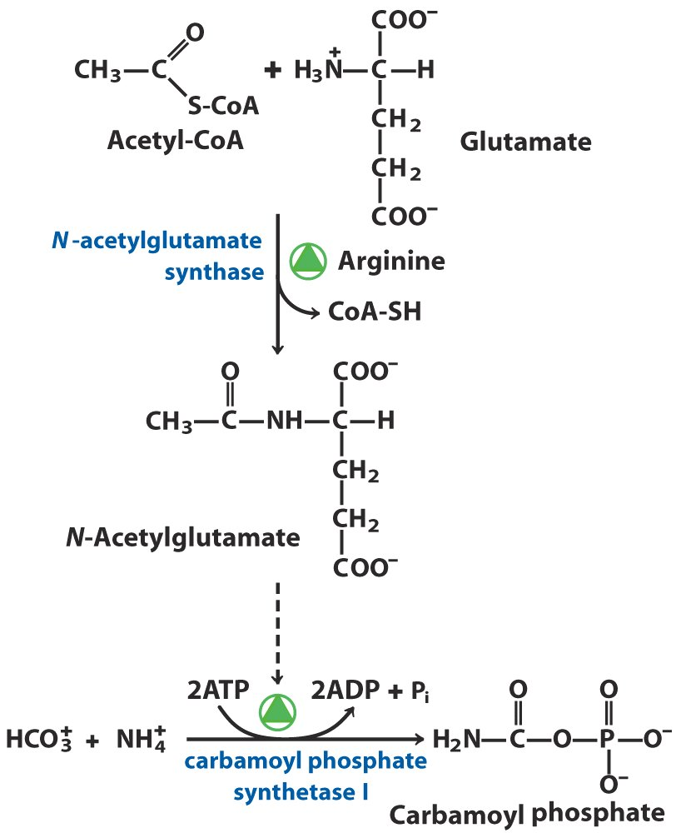
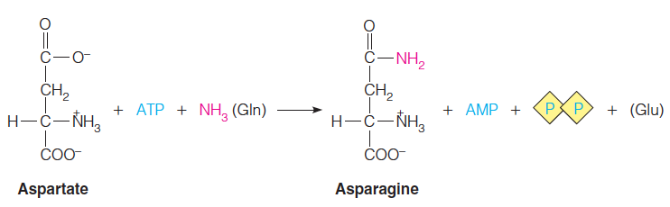
CH20 No.18
CPS1----mitochondria
CPS2----cytosol

Slide 35
請列出glutamate dehydrogenase所催化的反應(含參與之cofactors)
Glutamate→a-ketoglutarate (NAD⁺ orNADP⁺)

Slide 36
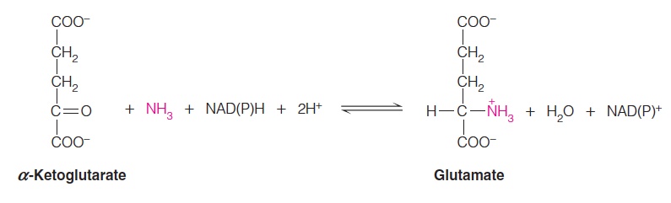
CH20 – No.20
K_{M}~1 mM
Glutamate dehydrogenase

Slide 37
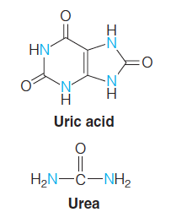
CH20 - No.21
Mitochondria matrix
Cytosol

Slide 38
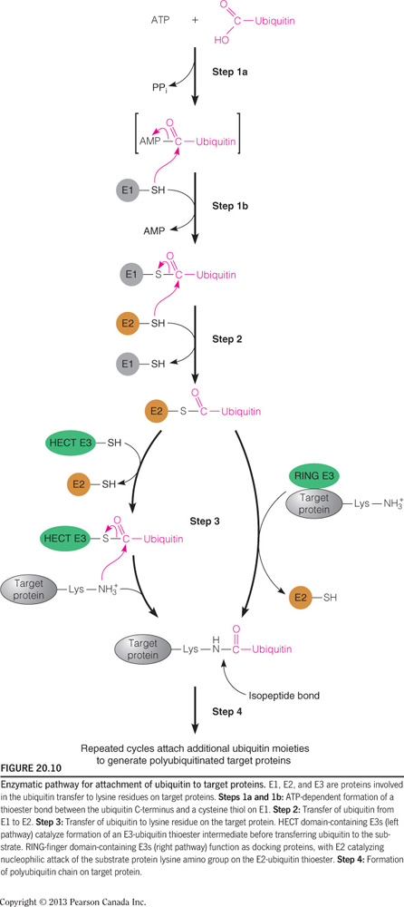
CH20 – No.22

Slide 39
CH20 – No.23
即富含Proline(P)、Glutamate(E)、Serine(S)、Threonine(T)的區域。若一蛋白質有一個或多個PEST序列，則較易被proteasome分解，壽命比較短。因此科學家將PEST序列視為蛋白質分解的標記。

Slide 40
CH20 – No.24
若蛋白質N端是:環(Phe、Tyr、Trp)、鹼(Lys、Arg)、Leu，則此蛋白質half-life較短。

Slide 41
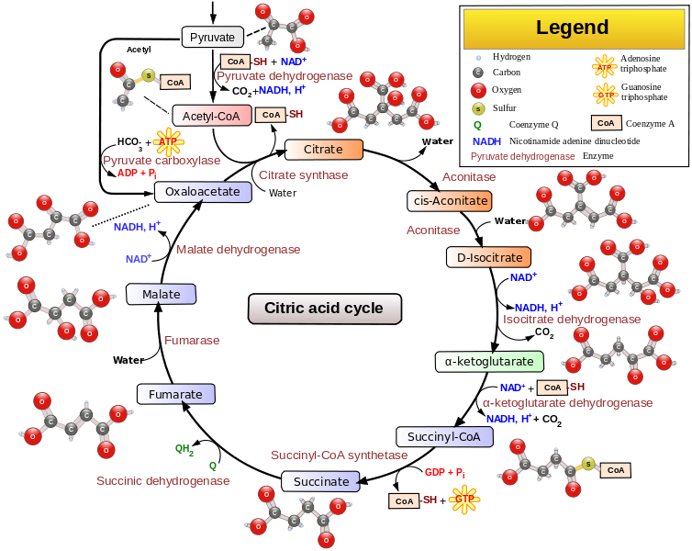
CH20 – No.25

Slide 42
CH 21 Metabolism of Nitrogenous Compounds ll: Amino Acids, Porphynns,and Neurotransmitters

Slide 43
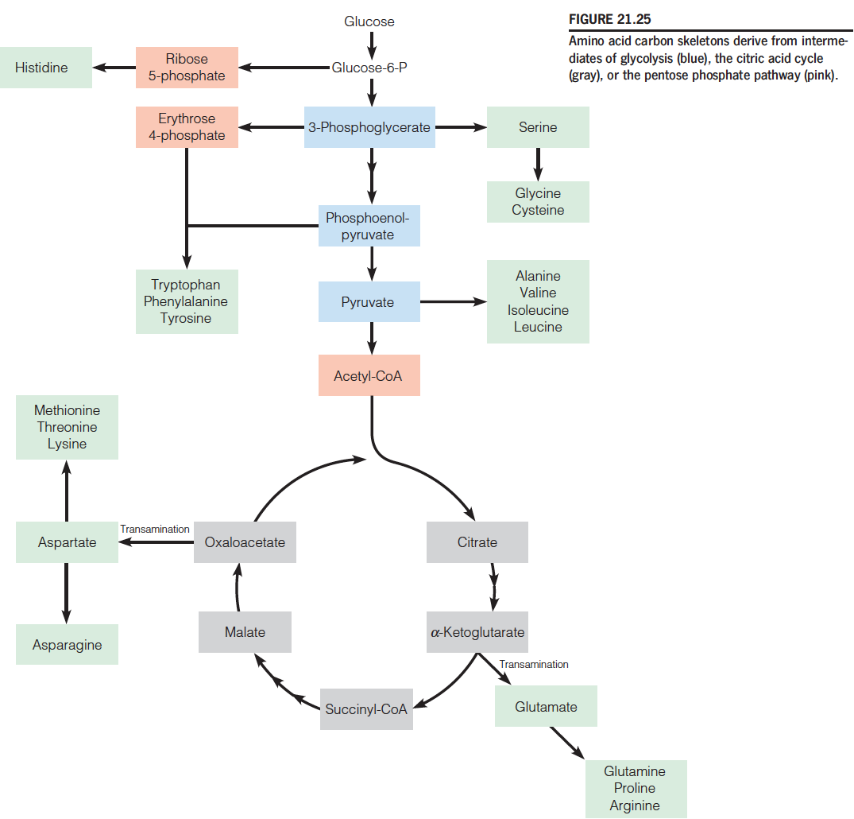
CH21 No.0

Slide 44
CH21 No.1

Slide 45
CH21 No.2

Slide 46
CH21 No.3

Slide 47
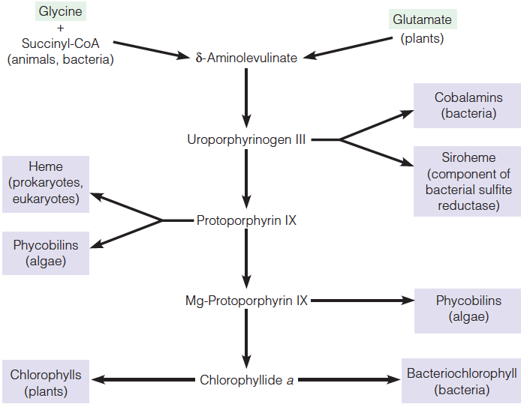
CH21 – No.4

Slide 48
CH21 – No.5
白子缺乏tyrosinase

Slide 49
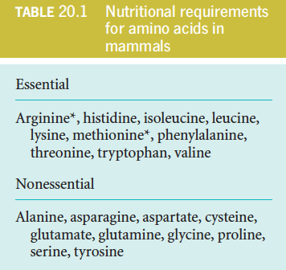
CH21 – No.6

Slide 50
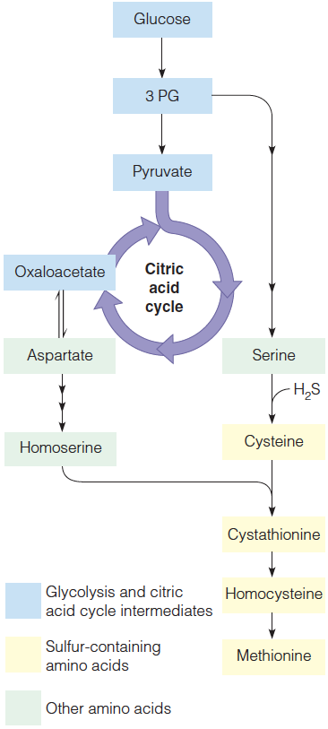
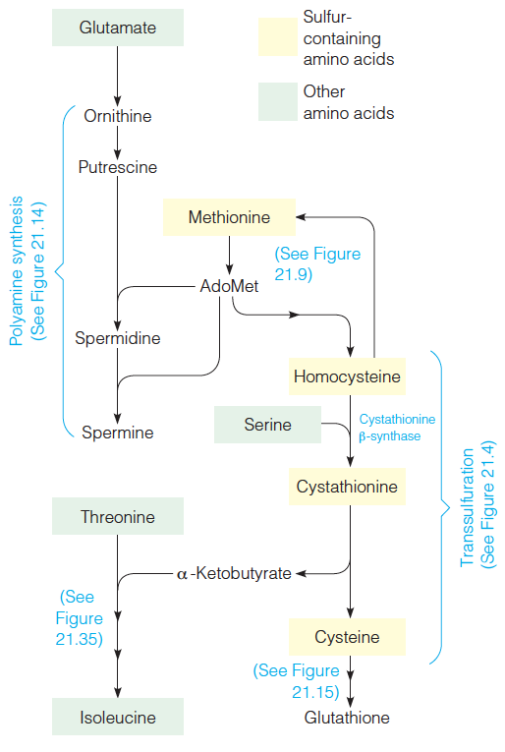
CH21 – No.7
Animal
Bacteria and Plants

Slide 51
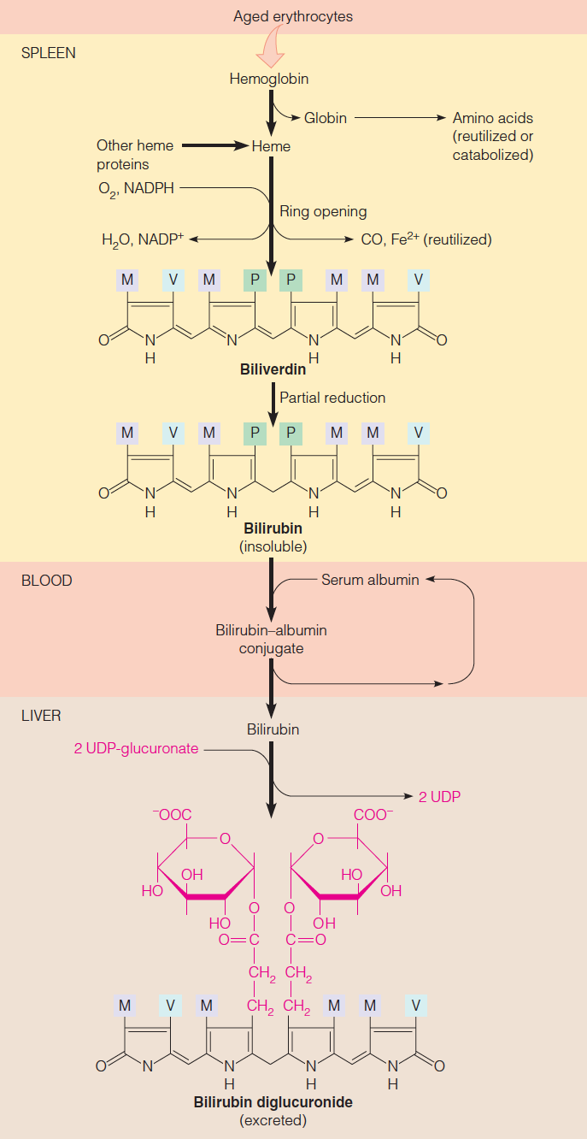
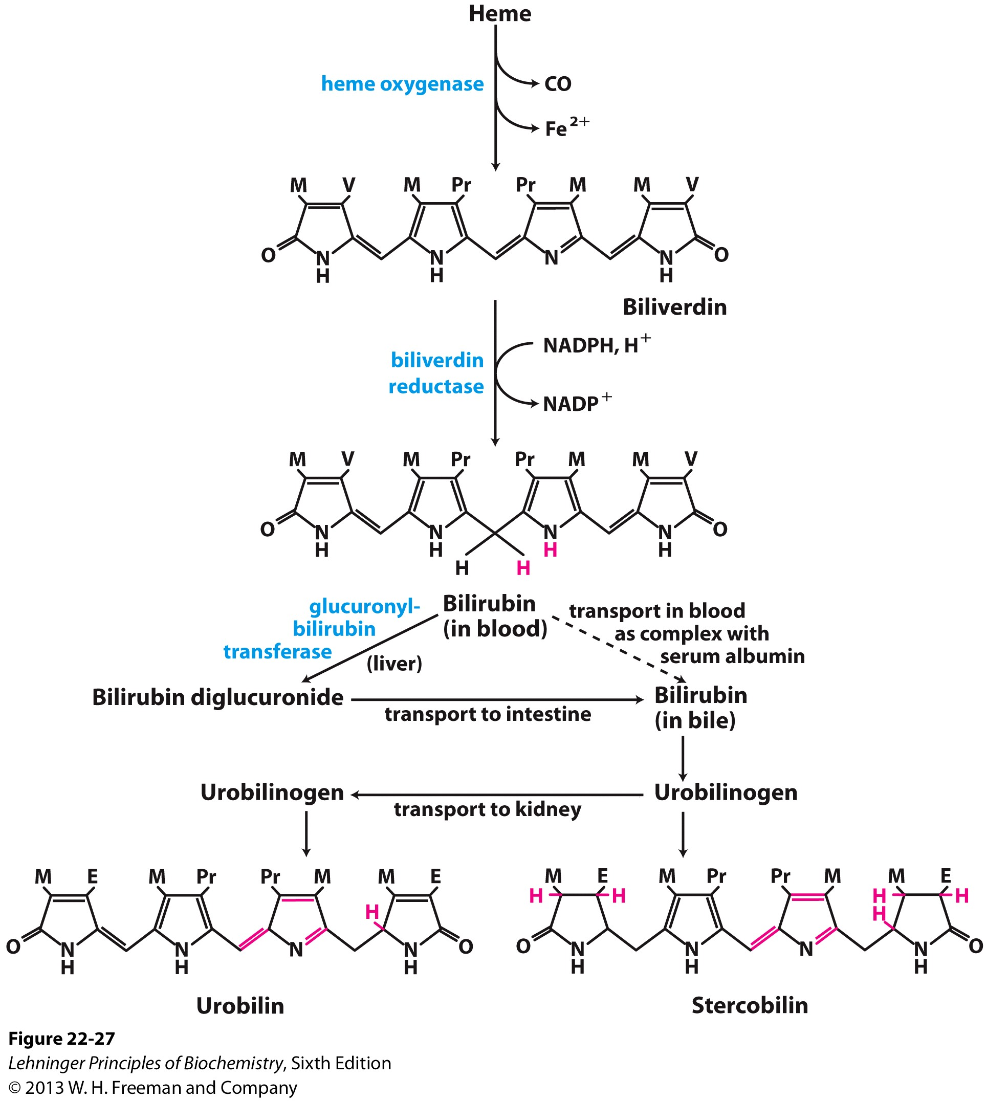
CH21 – No.8

Slide 52
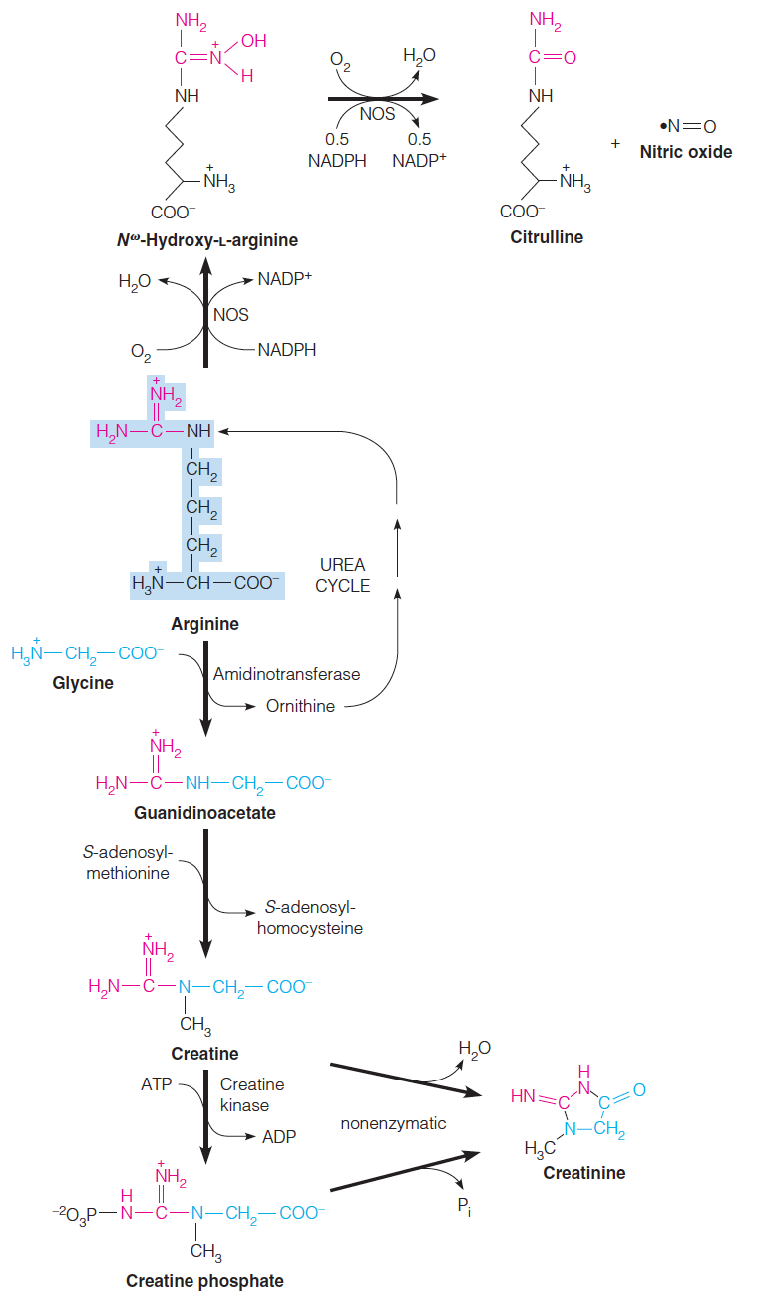
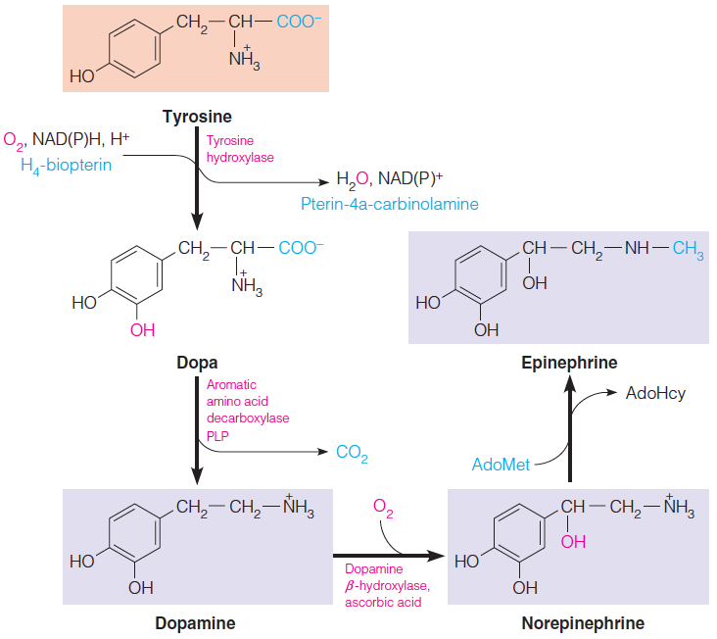
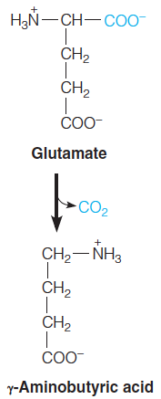
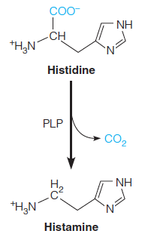
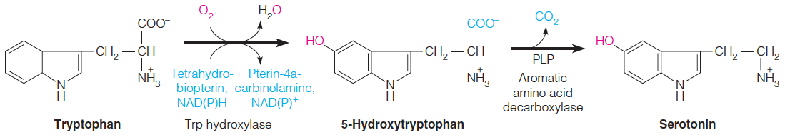
CH21 – No.9

Slide 53
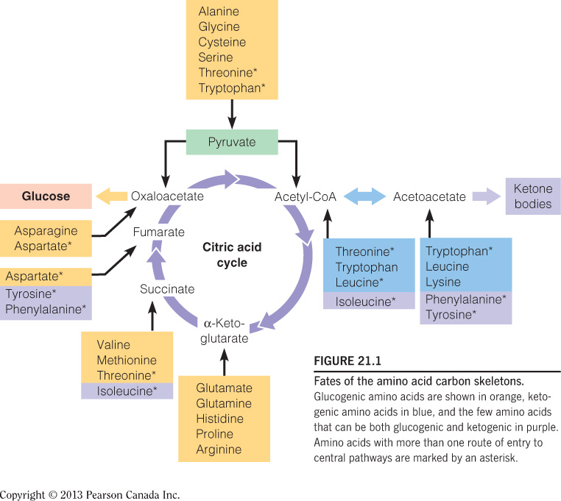
CH21 – No.10

Slide 54
CH21 – No.11

Slide 55
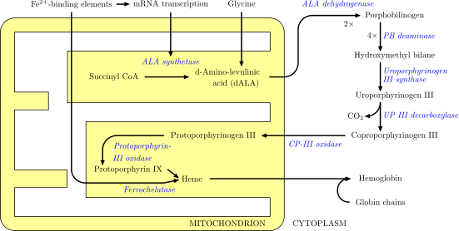
CH21 – No.12

Slide 56
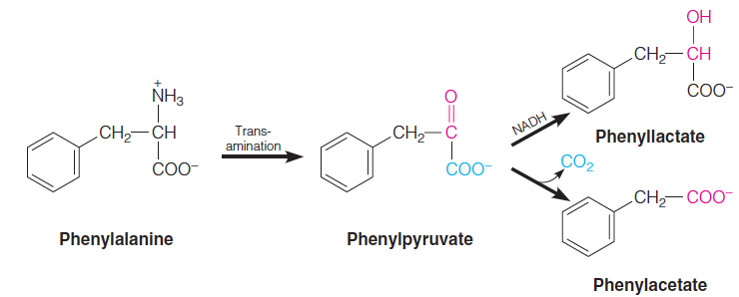
CH21 – No.14
遺傳性缺乏酵素phenylalanine hydroxylase，轉為tyrosine的路徑受阻使phenylalanine累積高濃度於體內(hyperphenylalaninemia)，這些過多的phenylalanine會透過其他較少用到的路徑代謝為phenylpyruvate(屬於phenylketone)，接著會再進一步代謝為phenyllactate and phenylacetate。

Slide 57
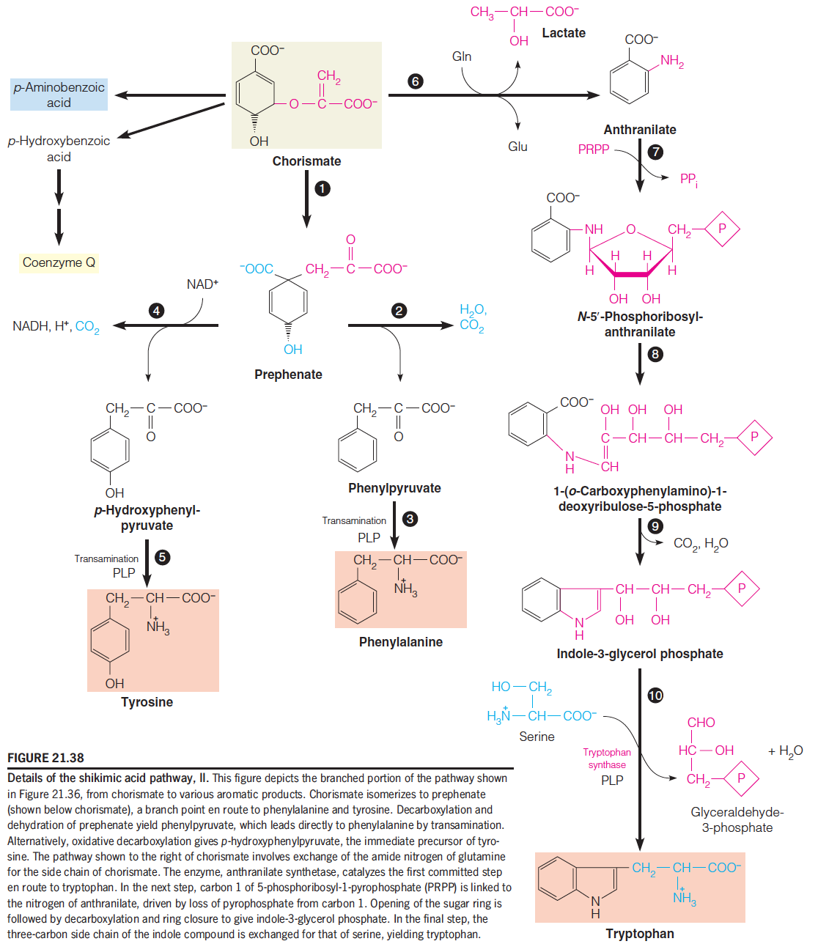
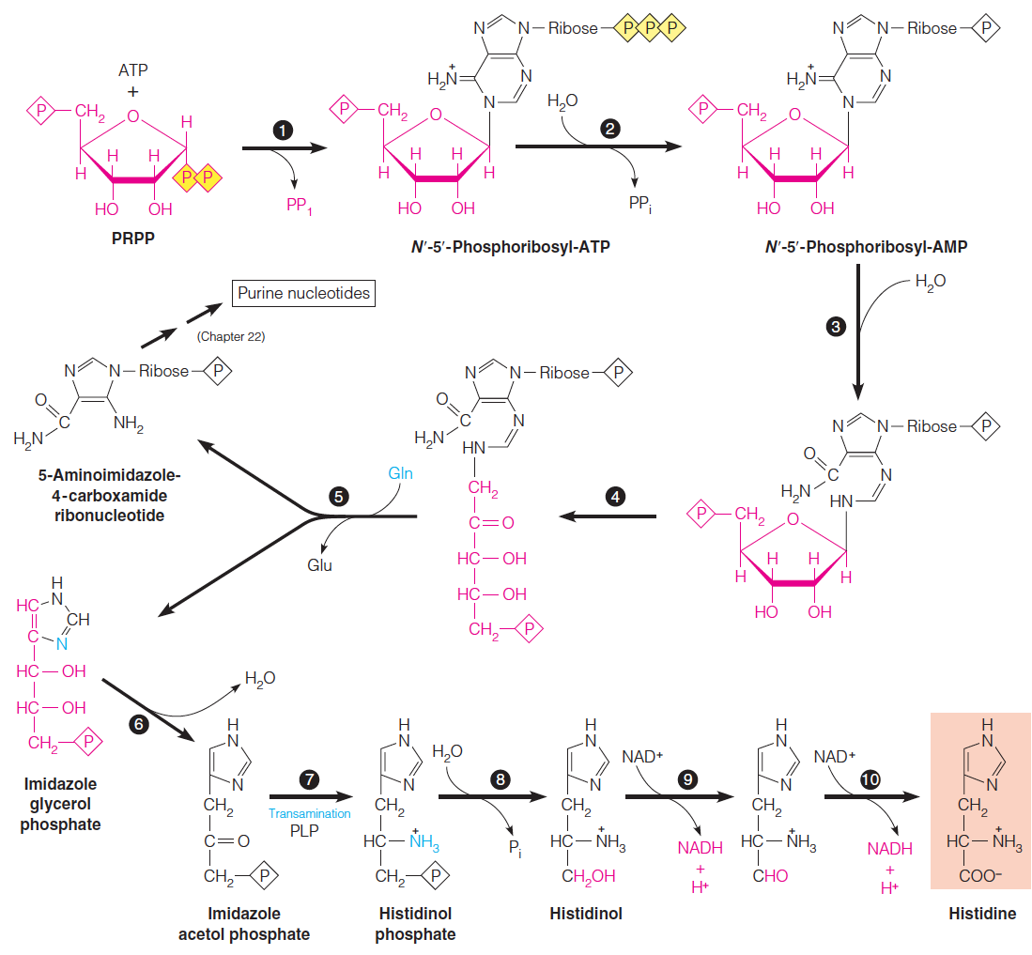
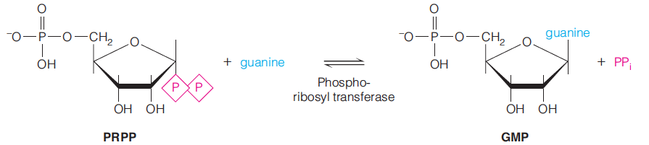
CH21 – No.15

Slide 58
CH21 – No.16

Slide 59
CH21 – No.17

Slide 60
CH21 – No.18

Slide 61
CH21 – No.19

Slide 62
CH21 – No.20
Phenylalanine和其代謝物(phenyllactate, phenylacetate)堆積
Reference : No.14

Slide 63
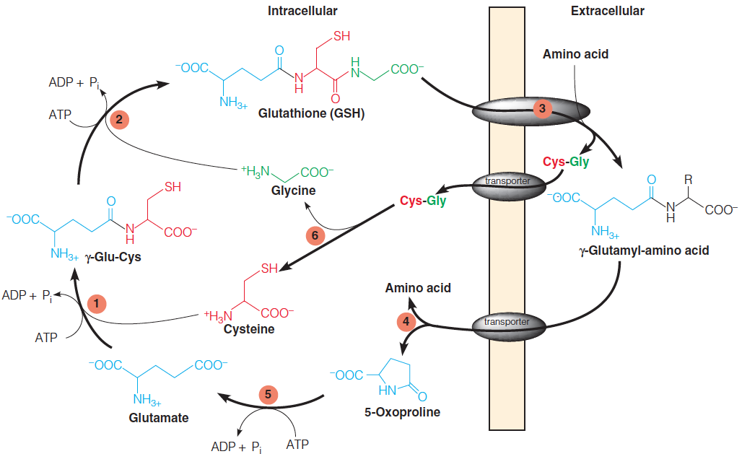
CH21 – No.21
transport amino acids into the cell

Slide 64
CH21 – No.22

Slide 65
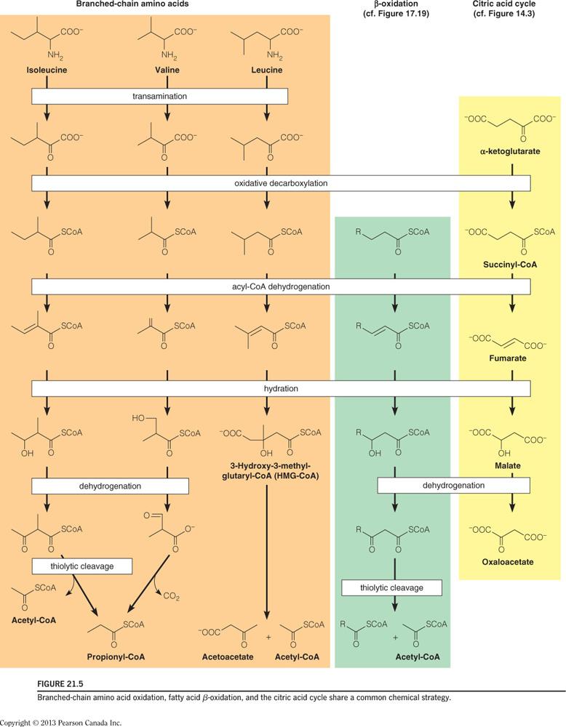
CH21 - No.23
Branched chain α-keto acid dehydrogenase complex
maple syrup urine disease :
Branched chain α-keto acid dehydrogenase complex deficiency

Slide 66
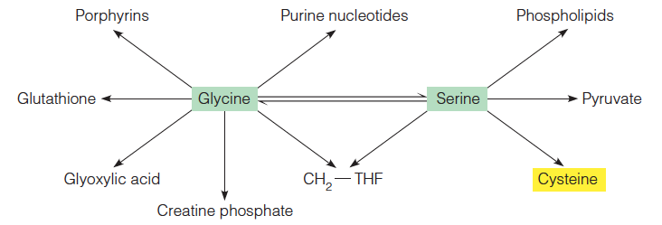
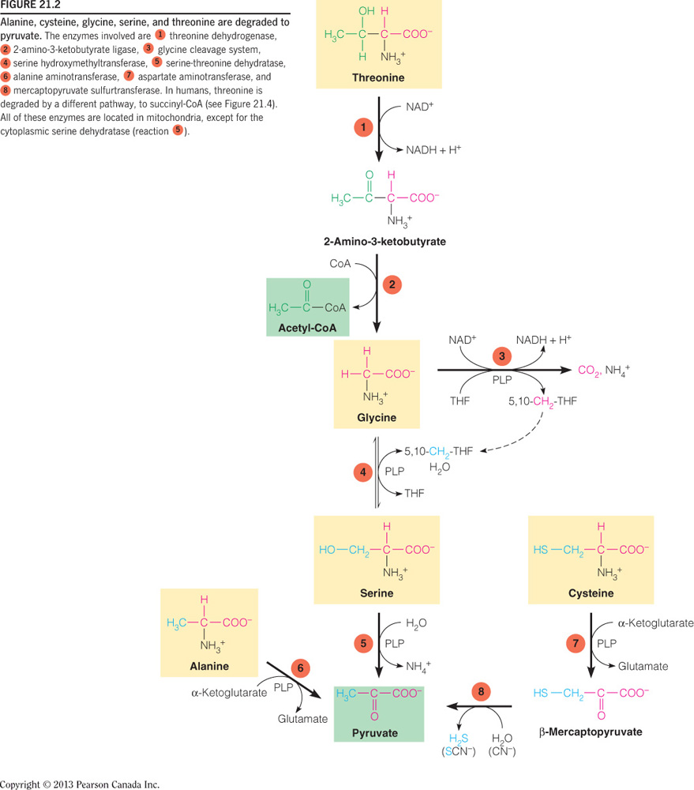
CH21 – No.24

Slide 67
CH21 – No.25
PKU :
Phenylalanine hydroxylase, Dihydropterin reductase

Slide 68
CH21 – No.26
Porphyria：尿液呈紅色
Alkaptonuria (黑尿症)：尿液呈黑色
PKU、Alkaptonuria：尿液有霉味
maple syrup urine disease：尿液有楓糖味

Slide 69
CH 22 Nucleotide Metabolism

Slide 70
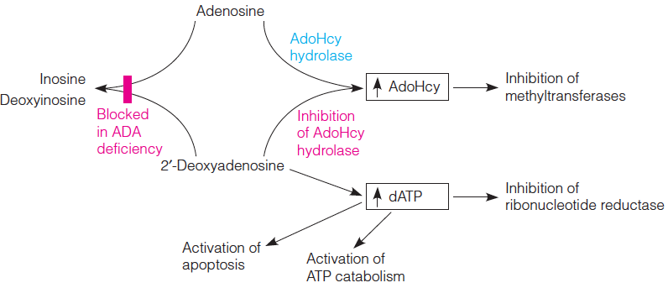
CH22 No.1
Because of accumulation of dATP , T cells are damaged , the immune system is affected

Slide 71
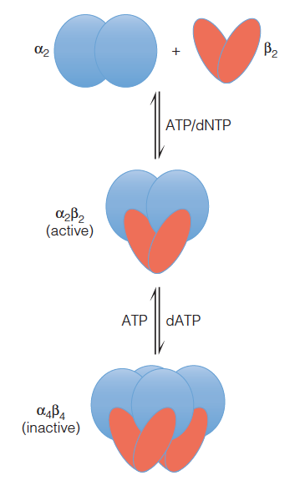
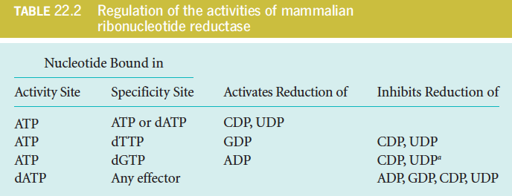
CH22 - No.2

Slide 72
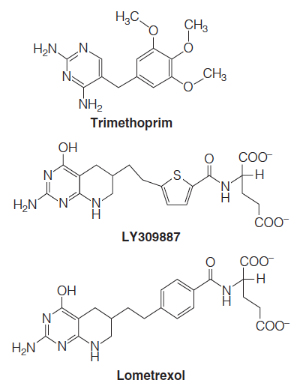
CH22 – No.3
針對dTMP合成，Trimethoprim是一種dihydrofolate reductase(二氫葉酸還原酶)抑制劑，模擬tetrahydrofolate或7,8-dihydrofolate，抑制dihydrofolate reductase活性，對細菌的dihydrofolate reductase結合能力是對哺乳動物的十萬倍。同時，Trimethoprim常與磺胺類藥物(Sulfonamide drugs)一起服用抑制葉酸的合成，中斷整個反應路徑。用於治療細菌感染和某些形式的瘧疾。
Inhibit de novo purine synthesis

Slide 73
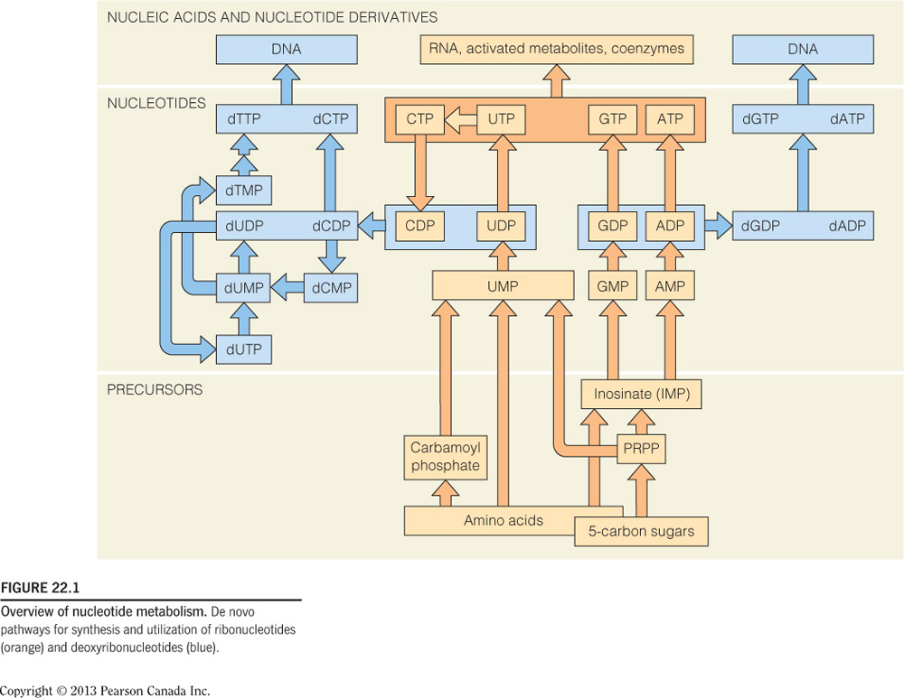
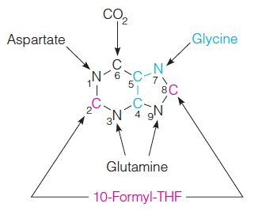
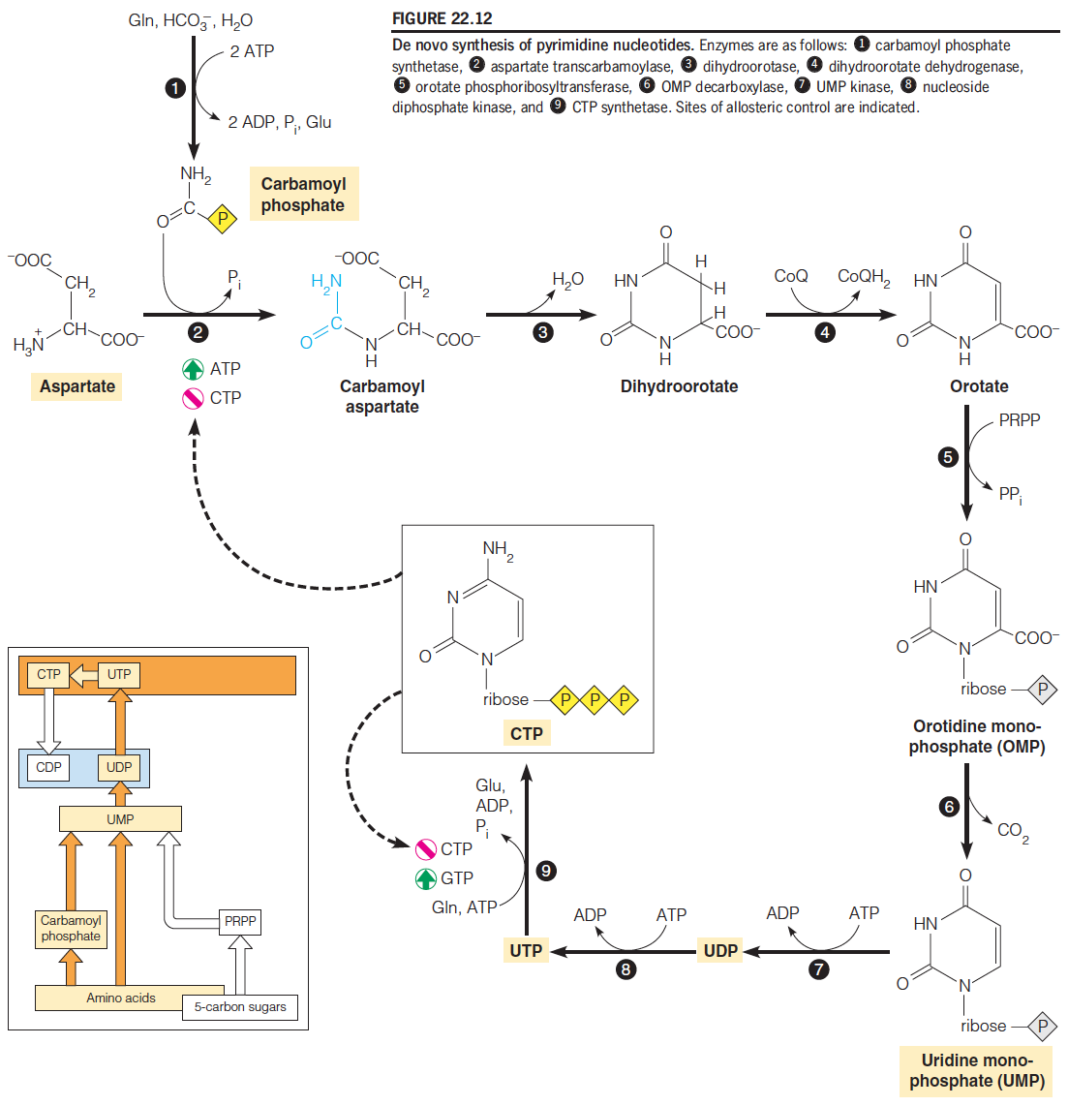

CH22 No.4
Purine :
+ ribose -> ring
Pyrimidine :
Ring -> + ribose

Slide 74
CH22 – No.5

Slide 75

CH22 – No.6
Lesch-Nyham syndrome:
是一種X染色體的遺傳疾病，無法合成HGPRT (hypoxanthine-guanine phosphoribosyltransferase)，造成guanine, hypoxanthine累積，PRPP上升 → purine大量合成 → 大量uric aid生成。此類病人會具有嚴重的關節炎，有自虐的傾向以及神經系統的發育不全。

Slide 76
CH22 – No.7
Carbamoyl phosphate synthetase (CPS) :
I:作用在matrix, urea synthesis, free NH₄
II:作用在cytosol, pyrimidine synthesis, glutamine
都是形成carmamoyl phosphate

Slide 77

CH22 – No.8
All purine degradation leads to uric acid.

Slide 78

CH22 – No.9

Slide 79

CH22 – No.10
Inhibit purine metabolism
More soluable

Slide 80
CH22 – No.11
過量的尿酸(insoluble)累積:造成痛風。
PRPP synthetase become resistant to feedback inhibition，PRPP過多因而造成尿酸製造過多。
缺乏hypoxanthine-guanine phosphoribosyltransferase(HGPRT)，因而在salvage pathway中，hypoxanthine及guanine無法藉PRPP轉為IMP及GMP。PRPP沒被消耗，PRPP過多因而造成尿酸製造過多(Adenine則是經APRT的salvage pathway)。
Glucose-6-phosphatase deficiency造成Glucose-6-phosphate過多，進入pentose phosphate pathway增加，造成PRPP過多，而造成尿酸製造過多。
uric acid overproduction

Slide 81
CH22 – No.12
舉出三例病毒特有之酵素(或生合成路徑)可以作為抗病毒藥物開發的標的
P950.951 AZT,

Slide 82
CH22 – No.13
aminotransferase與amidotransferase有何不同處
Aminotransferase轉氨酶：L-amino form → α−keto form (alanine, aspartate)
Amidotransferase轉醯胺酶：transfer amino groups derived from the amide nitrogen (glutamine)

Slide 83
CH22 No.14
試說明fluorouracil, methotrexate這兩種抗癌藥物所針對的酵素或反應路徑的作用機制
Fluorouracil →FdUMP－
與thymidylate synthase結合抑制thymine的合成
Methotrexate(trimethoprim,aminopterin)－
folate analog以100倍的親和力與dihydrofolate競爭，dihydrofolate reductase抑制H4 folate生成

Slide 84

CH22 No.15
adenine and guanine nucleotides生合成的均衡調控機制為何(以E. coli.為例)
p924.925

Slide 85
CH22 – No.18
舉出三例酵素或酵素複合體在結構上形成分子通道,可以使不穩定的中間產物順利傳送至下一個酵素作用位置
UMP-synthase, CAD, (Pyruvate dehydrogenase)

Slide 86
CH22 – No.4
舉出四種生物體將游離氨NH₄鍵結至有機分子之反應
藉由glutamine synthetase鍵結到Glu上而形成Gln
藉由glutamate dehydrogenase鍵結到α-Ketoglutarate而形成Glu
The other two should be of Aspartate & Apsparagine

Slide 87
CH22 – No.13
回饋抑制是含氮生物分子合成的主要調控方式,一種上游的原料分子可用於合成多種不同的下游分子,細菌運用哪些特殊的回饋抑制機制節能,並確保下游分子的均衡合成
Cumulative feedback inhibition P829

Slide 88
CH22 – No.27
α−ketobutyrate是哪些胺基酸的代謝產物,它又是哪些胺基酸合成的原料
Methionine, Threonine → α−ketobutyrate
α−ketobutyrate → Isoleucine

Slide 89
Supplement tests

Slide 90
PS – No.1
請列出三個需要金屬離子輔助之酵素
(1)固氮酶 Nitrogenous，為molybdenum(Mo)-dependent enzyme
(2)Nitrate reductase ，包含Fe₄S₄複合體
(3)Glutamine synthetase 需要Mn₂⁺

Slide 91
PS – No.2
哪些因素可造成homocysteinemia
a.遺傳缺陷(可參考PPT20 的代謝圖&說明)
(1)Cystathionine β–synthase（與分解缺陷有關）
(2)Methionine synthase（與合成缺陷有關）
(3)5,10-Methylenetetrahydrofolate reductase(5,10-Methyl-THF)
b.飲食缺陷
(1)葉酸(Folicacid)
(2)Vitamin B6
(3)Vitamin B12

Slide 92

PS – No.3
合成dTMP的原料-dUMP的來源有哪些
UDP CDP

Slide 93
PS – No.5
2’,3’-dideoxyribonucleoside的抗病毒機制為何?
加上磷酸根形成核苷類似物(即ddNTP) ,作為合成 DNA 原料 , 但因其" C3上缺一個 O"(即只接一個H), 可以終止 DNA 序列繼續延長 (chain terminators)

Slide 94
PS – No.6
以folic acid之類構物作為化療藥物可針對哪兩種酵素?
(1)dihydrofolate reductase
(2)thymidylate synthase

Slide 95
PS – No.7
細胞如何避免dUTP被使用於DNA複製
(1)加入FdUMP
(2)加入antifolates

Slide 96
Dr.Wong 97

Slide 97
97-1
Which of the following statement is the most precise modern definition of gene?
A.a segment of genetic material that determines one phenotype
B.a segmemt of genetic material that codes for one enzyme
C.a segment of genetic material that codes for one polypeptide
D.a segment of genetic material that codes for one polypeptide or RNA product

Slide 98
97-2
The fundamental repeating unit of organization in an eukaryotic chromosome is:
(A)the centrome
(B)the microsome
(C)the nucleosome
(D)telomere

Slide 99
97-3
The linking number(LK) of a closed-circular, double-stranded DNA molecule may be changed by:
(A)underwind without the breaking of any phosphodiester bonds
(B)supercoiling without the breaking of any phosphodieater bonds
(C)breaking the hydrogen bonds in the DNA
(D)breaking one of the strands, unwinding the DNA,
then rejoining the strand

Slide 100

97-4
The histone core of a nucleosome is consister of:
(A)one copy each of histones H1,H3 and H4
(B)two copies each of H1,H3 and H4
(C)one copy each of H2A,H2B,H3 and H4
(D)two copies each of H2A,H2B,H3 and H4

Slide 101

97-5
PolymeraseI,not PolymeraseII or III can conduct "nick translation." This is because only PolymeraseI have
(A)3'-5'exonucleasxe
(B)5'-3'exonucleasxe
(C)endonuclease
(D)polymerization

Slide 102

97-6
From our current understanding of all the known DNA polymerases, the DNA chain elongation at a replication fork can not be:
A.continuous on the leading strand ,but discontinuous in the lagging strand
B.discontinuous on both strands,
C.continuous on both strands,
D.all of above

Slide 103


97-7
在DNA replication initiation時，需要讓helicase loading上replication的region，試問在E. coli中是需要藉由甚麼來達成
(A)DnaA
(B)DnaG
(C)DnaA+DnaC
(D)DnaA+DnaG

Slide 104
97-11
Which enzyme is used to remove RNA primer from the Okazaki DNA fragments in E.coli cells?
A.DNA PolI
B.DNA PolII
C.DNA PolIII
D.RNA polymerase

Slide 105

97-12
the major constituents of the E.coli primosome are:
A.the DnaB helicase and DnaG primase
B.the DNA gyrase and DnaB helicase
C.the DNA gyrase and DnaG primase
D.the DnaG primase and DnaA protein

Slide 106

97-16
Transposition can be distinguished from other types of recombination in that the target site in the recipient DNA becomes:
A.deleted
B.duplicated and located in each side of the insertion with the same order
C.duplicated and located in each side of the insertion wiht inverted order
D.amplified

Slide 107


97-17
Recombination between two inverted repeats in the same DNA molecule can generate:
(A)inversion of the DNA fragment flanked by the repeats
(B)deletion of the DNA fragment flanked by the repeats
(C)duplication of the DNA fragment
(D)none of above

Slide 108

97-22
Direct repair of O^6-methyl guanine in the DNA is catalyzed by
(a)photolyase
(b)AlkB dioxygenase
(c)methyl transferase
(d)guanine glycosylase

Slide 109
Dr.Wong 96

Slide 110
96-4
Fot a closed-circular DNA molecule of 10,000 base pairs in the fully relaxed form, the linking number(LK)is about:
A.10000
B.950
C.100
D.9.5

Slide 111
96-7
Which of the following statement is incorrect?
(A)RNA may be used as primer for DNA synthesis
(B)DNA chain elongation is 3' to 5'
(C)DNA polymeraseⅢ is the replicating enzyme used in E.coli
(D)Primers, DNA template and 4 dNTPs are required for DNA synthesis

Slide 112
96-9
Topoisomerases can:
A.change the number of basepairs in a DNA molecule
B.change the linking number of a DNA molecule
C.convert D isomer of nucleotides to L isomer
D.synthesize RNA primer

Slide 113
96-10
Which protein is involved only in the initiation of DNA replication but not at the DNA chain elongation process in E.coli cells?
A.DnaA
B.DnaB
C.primase
D.SSB

Slide 114
96-12
Which of the following subunits is required for the optimal processivity of E.coli DNA Pol III?
A.alpha subunit
B.gamma comples
C.beta subunit
D.tau subunit

Slide 115
96-15
Which protein can catalyze the pairing of a single-strand DNA molecule with a complementary region of a duplex DNA molecule:
A.RuvAB
B.RecBCD
C.RecA
D.SSB

Slide 116
96-16
Transposition can be distinguished from other types of recombination in that the target site in the recipient DNA becomes:
A.deleted
B.duplicated and located in each side of the insertion with the same order
C.duplicated and located in each side of the insertion wiht inverted order
D.amplified

Slide 117
96-17
Recombination between two inverted repeats in the same DNA molecule can generate:
(A)inversion of the DNA fragment flanked by the repeats
(B)deletion of the DNA fragment flanked by the repeats
(C)duplication of the DNA fragment
(D)none of above

Slide 118
96-18
Which of the following DNA repair process is used to repair the presence of uracil in the DNA
(a)nucleotide exicision repain
(b)mismatch repair
(c)methyl transferase
(d)base excision repair

Slide 119
96-19
What type of DNA damages are recognized and repaired by nucleotide-excision repair system:
A.DNA double-Strand breaks
B.abnormal bases
C.lesion that cause structure changes
D.AP sites

Slide 120
96-20
Dam-dependent mismatch repair system can repair mismatch(eg.,GT) generated after replication.What is the role of methylation by DNA adenine methylase (dam) in this repair process?
A.to induce the synthesis of repair enzymes
B.to inhibit DNA chain elongation
C.to stimulate DNA recombination
D.to distinguish newly-synthesized strand from the old template strand

Slide 121
96-21
The Ames test is used to
(a)detect bacterial virus
(b)determine the rate of DNA replication
(c)exam the potency of antibolitics
(d)measure the mutagenic effect of various chemical compound

Slide 122
96-22
Which is correct about that the Linking Number of DNA cannot:
(a) be present while being transcripted
(b) be present when two strands of DNA are coiled together
(c) occur when there is a nick in the double helix
(d)occur in compact DNA

Slide 123
Dr.Wong 95

Slide 124
95-4
Which activity of bacterial DNA polymerase is used for editing(proofreading)?
A.3' to 5' exonuclease
B.5' to 3' exonuclease
C.RNAse H
D.polymerization activity

Slide 125
95-11
Which enzyme is used to remove RNA primer from the Okazaki DNA fragments in E.coli cells?
A.DNA PolI
B.DNA PolII
C.DNA PolIII
D.RNA polymerase

Slide 126
95-14
Damaged base in DNA can be removed by specific glycosylase to produce:
A.a break or nick in DNA backbone
B.an AP site
C.a double-strand break
D.ATP, which is subsequently

Slide 127
95-16
Which protein can catalyze the pairing of a single-strand DNA molecule with a complementary region of a duplex DNA molecule:
A.RuvAB
B.RecBCD
C.RecA
D.SSB

Slide 128
95-18
Which of following DNA repair process can reverse the UV-induced photoproduct,cyclobutadipyrimidines, directly to its original state (i.e., two pyrimindines):
A.excision repair
B.mismatch repair
C.recombination repair
D.enzymatic photoreactivation

Slide 129
95-19
What type of DNA damages are recognized and repaired by nucleotide-excision repair system:
A.DNA double-Strand breaks
B.abnormal bases
C.lesion that cause structure changes
D.AP sites

Slide 130
Dr.Wong 101

Slide 131
101-4
The superhelical density of a closed circular DNA, which is 1050 bp and has the linking number of 93, is about?
(A) -0.01
(B) -0.07
(C) 0.07
(D) 10.7
1050/10.5=100 93-100=-7 -7/100=-0.07

Slide 132
101-7
Which of the following statements is incorrect?
(A) RNA may be used as primer for DNA synthesis
(B) DNA chain elongation is 5’ to 3’
(C) DNA polymerase II is the replicating enzyme used in E. coli 應為pol3
(D) Primers, DNA template and all 4 dNTPs are required for DNA synthesis

Slide 133
101-9
What kind of DNA damage will occur if human cells are treated with type II topoisomerase inhibitor?
(A) Base damage
(B) single-strand breaks
(C) double-strand breaks
(D) AP sites

Slide 134
101-13
Which protein complex in eukaryotes has the activity similar to DnaB in E-coli?
(A) ORC
(B) MCM2-7 (DNA helicase)
(C) SMC protein
(D) Large T antigen

Slide 135
101-15
Which protein can catalyze the pairing of a single-strand DNA molecule with a complementary region of a duplex DNA molecule?
(A) RuvAB
(B) RecBCD
(C) RecA
(D) SSB

Slide 136
101-18
TT-dimer 要怎麼修復
Direct repair: by DNA photlyases

Slide 137
Dr.Wong 100

Slide 138
100--3
Approximately what function of the human genome arre transposable elements?
(a) 1.5%
(b) 5%
(c) 45%
(d) 80%

Slide 139
100-11
When a DNA molecule is described as replicating bidirectionally , it means that it has?
(a)chain
(b)independently replicating segments
(c)origin
(d)replication forks

Slide 140
100-12
The DNA in a eukaryotic chromosome is best described as :
(A)A single circular double-helix molecule.
(B)A single linear double-helix molecule.
(C)A single linear single-stranded molecule.
(D)Multiple linear double-helix molecules.

Slide 141
100-15
The function of the eukaryotic DNA replication factor PCNA (proliferlating cell nuclear antigen) is similar to that of the beta-subunit of bacterial
DNA polymerase III in that it
(a)facilitates replication of telomeres
(b)form a circular sliding clamp to increase the processivity of replication
(c)has a 3' to 5' proofreading activity
(d)increase the speed but not the processivity of the replication complex

Slide 142
100-16
Can be distinguished from other types of recombination in that the target site in the recipient DNA sequences:
(a)deleted
(b)replication and located in each type of the insertion with the same orientation
(c)replication and located in each type of the insertion with the inverted orientation
(d)amplified

Slide 143
100-18
Which of the following DNA repair process is used to repair the presence of uracil in the DNA?
(A)nucleotide excision repair
(B)mismatch repair
(C)methyl transferase
(D)base excision repair

Slide 144
100-21
The Ames test is used to
(a)detect the bacterial viruses
(b)determine the rate of DNA replication
(c)examine the potency of antibiotics
(d)measure the mutagenic effects of various chemical compounds

Slide 145
100-22
It is correct to say that DNA supercoil cannot
(a)be induced by strand seperation
(b)be induced by underwinding double helix
(c)occur when a closed-circular double-strand DNA has a nick
(d)result in DNA compacting

Slide 146
100-23
In base-excision repair, the first enzyme to act is
(a)AP endonuclease
(b)Dam methylase
(c)DNA glycosylase
(d)DNA polymerase

Slide 147
100-14
In homologous genetic recombination, RecA protein is involved in
(a)formation of Holliday intermediates and branch migration
(b)nicking the two duplex DNA molecules to initiate the reaction
(c)pairing a DNA strand from one duplex DNA molecule with sequences in another duplex, regardless of complementarity
(d)resolution of the Holiday intermediate

Slide 148
Dr.Wong 99

Slide 149
99-4
The superhelical density of a closed circular DNA, which is 1050 bp and has the linking number of 107, is about?
(A)-0.01
(B)-0.7
(C)0.07
(D)10.7

Slide 150
99-9
What kind of DNA damage will occur if human cells are treated with type II topoisomerase inhibitor?
(A) base damage
(B) single-strand breaks
(C) double-strand breaks
(D) AP sites

Slide 151
99-14
Damaged base in DNA can be removed by specific glycosylase to produce:
A.a break or nick in DNA backbone
B.an AP site
C.a double-strand break
D.ATP, which is subsequently

Slide 152
Dr.Wong 98

Slide 153
98-12
Dam-dependent mismatch repair system can repair mismatch(eg. GT) generated after replication. What is the role of methylation by DNA adenine methylation (dam) in the repair enzymes
(a) to induces the synthesis of region enzyme
(b) to inhibit DNA chaion enlongation
(c) to stimulate DNA recombination
(d) to distinguish mehtyl-synthesized strand from the old template strand

Slide 154
98-14
Direct repair of 3-methylcytosine requires which of following?
(A)photolyase
(B)AlkB dioxygenase
(C)methyl transferase
(D)3-methylcytosine transferase

Slide 155
98-15
Which subunit is not require for elongation of RNA polymsease?
(A)beta
(B) apha
(c)w
(D) sigma

Slide 156
98-16
Briefly describe the function of RecBCD and RecA in the homologous recombination.
RecBCD has the function of helicase and nuclease.
RecB(3’to 5’) RecD(5’to 3’) RecC combine with chi sequence and cleave 5’terminus
RecA promote joint molecule formation and strand exchange+

Slide 157
Dr.Zhen

Slide 158
Zhen-1
DNA和RNA合成中都需有什麼？(94,96)
5'triphosphate。

Slide 159
Zhen-2
Phosphophenolpyvurate(PEP)在hydrolysis之後如何穩定？(94,95,97)
Tautomerization。

Slide 160
Zhen-3
products為何比reactants穩定？(94)
因為electrostatic repulsion released by charged separation、ionization、resonance和tautomerization的關係。

Slide 161
Dr.Zhen-homework

Slide 162

HW-1
Which of the following metabolic flux is decreased during starvation?
lipolysis
β-oxidation
ketogenesis
citric acid cycle

Slide 163
HW-2
Type 2 diabetes is distinct from type 1 diabetes in that:
type 2 diabetes is treatable with insulin administration.
type 2 is associated with an inability to produce insulin.
type 2 is associated with increased blood glucose levels.
type 2 diabetes is associated with an inability to respond to insulin.

Slide 164

HW-3
Which of the following hormone/molecule promotes food intake?
activation of AMPK
insulin
activation of PI3K-mTOR
leptin

Slide 165

HW-4
Which of the following is false?
during fasting, high NAD/NADH ratio activates SIRT1 to deacetylate PGC-1.
result in decreased gluconeogenesis in liver.
result in increased fatty acid oxidation in skeletal and heart muscle.
AMPK phosphorylates and activates PGC-lα.

Slide 166

HW-5
Regarding AMPK signaling in of fuel metabolism, which of the following is false?
AMPK is activated when the energy charge of the cell is low.
AMPK is activated by high AMP/ATP ratio.
AMPK stimulating pathways that utilize ATP.
AMPK stimulates glycolysis in heart via stimulats PFK-2/FBPase-2 activity.

Slide 167

HW-6
Regarding mTOR signaling in of fuel metabolism, which of the following is false?
mTOR is active under nutrient-rich conditions.
Activated mTOR inhibits catabolic processes.
Akt induces mTORC1 activation.
TSC inhibits mTORC1 activation.

Slide 168

HW-7
What is the preferred fuel source of heart muscle?
Ketone bodies
Protein
Fatty acids
Glucose

Slide 169
Dr.Ko-101

Slide 170
101-3
RNA polymerase的哪個subunit會辨認promoter
(A) Alpha
(B) Beta
(C) Sigma
(D) Gamma

Slide 171
101-4
Which one is involved in the reaction with ribosome?
(A) Anticodon arm
(B) D arm
(C) t-phi-c arm
(d) Amino acid arm

Slide 172
101-5
Which sequence element promotes the translation initiation at ATG codon in eukaryotes?
(A) operator
(B) Kozak sequence
(C) Shine-Dalgarno sequence
(D) UPE sequence

Slide 173
101-10
Which factor is the specific signal molecule required for catabolic repression of E-coli lac operon?
(A) cAMP regulatory molecules (100考古)
(B) Allolactose
(C) beta-galactoside
(D) Glucose

Slide 174
Dr.Ko-100

Slide 175
100-2
Which is not needed for transcription?
(a)DNA template
(b)DNA-dependent RNA pol
(c)5'primer
(d)

Slide 176
100-3
Which enzyme is involved in synthesizing mRNA in eukaryotic cells?
(a)RNA polymerase II
(b)RNA-dependent RNA polymerase
(c)RNA polymerase I
(d)RNA polymerase III

Slide 177
100-4
which sequence signature determines the initiation ___ of translation in bacteria
a) TATA box
b) shine-dolgarno sequence
c) kozak sequence
d) 5' capping region

Slide 178
100-6
Which is the resource used in the mRNA elongation
(A)ATP
(B)CTP
(C)GTP
(D)TTP

Slide 179
100-8
Which of the following statements is correct about lac operon in bacteria?
(A)The lac operon is a positive inducer-dependent manner.
(B)Lactose is truly the inducer of the operon.
(C)The activated lac operon turns on the translation of lac Z, Y and A genes.
(D)The lac operon consist of a single operator.

Slide 180
100-9
lac operon的catabolite repression中，哪一個是
regulatory molecules?(大概題意)
(A)allolactose
(B)cAMP
(C)beta-galactosidase
(D)catabolite inducer protein
原因:glucose↓，cAMP(為inducer)↑，與catabolite repressor protein(CRP,為 activator)結合，bind to
promoter sequence→transcription

Slide 181
100-10
Which biological reaction is additionally necessary for gene regulation in eukaryotic cell?
(A)chromatin remodeling
(B)recognition of promoter sequence
(C)constitutive gene expression
(D)regulated gene expression

Slide 182
100-Q1
Please describe three types of RNA processing and their biological functions.
5’capping
Alternative splicing: exclude noncoding intron and form mature RNA
3’ poly A tail
5’capping&3’ poly A tail prevent RNA from degradation

Slide 183
100-Q3
please briefly describe the major types of RNA in eukaryotic and provide
the biological significance of them.
mRNA: a template for translation
rRNA: a machinery for synthesizing protein
tRNA: to read the information of mRNA

Slide 184
100-Q4
Please briefly describe the biological reactions involved in the initiation stage of translation in bacteria.
Small subunit(30s) of ribosome first bind to the mRNA.
IF-1 occupy A site to prevent the entrance of tRNA
IF-3 bind on 30s subunit to prevent too early combination of 30s and 50s.
IF-2 bring the fMet-tRNA with GTP to P site.
Then, 50s subunit bind to this complex, GTP hydrolyzed, and initiation factor release.

Slide 185
100-Q5
Please provide three types of protein post-translational modification and provide their biologicsl significance of gene regulation.
N-terminal & C-terminal modification
Acetylation (active translation)/ deacetylation (inactive translation)
Loss of signal sequences
Signal peptidase
Modification of individual amino acid
Ubiquitination and degradation

